Slide 1
The Evolution of a Modern power generating Unit

Slide 2
Components of a
Generating Unit
Furnace
Boiler
Turbine
Generator
Notes:
These are the components of a coal-fired power plant the most common type in existence. You may want to point out to your students that there other types of generating plants and not all of them rely on the combustion of a fuel. In Module 3, Unit C, alternate energy sources will be covered in more detail.

Slide 3
Components
Let’s look at each component individually and trace the developments that have helped to increase efficiency. It might help to picture a “tea kettle” plant to get started.

Slide 4
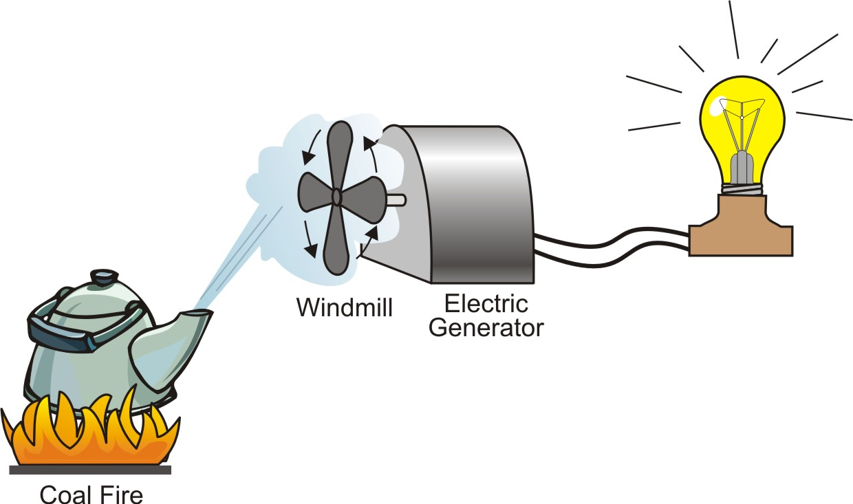
Tea Kettle Power Plant
Notes:
Describe what is happening in the picture. The fire heats water in the tea kettle creating a stream of steam that turns a windmill that turns magnet in the electric generator creating current flow. The wires and light bulb represent the transmission and distribution to an end user.

Slide 5
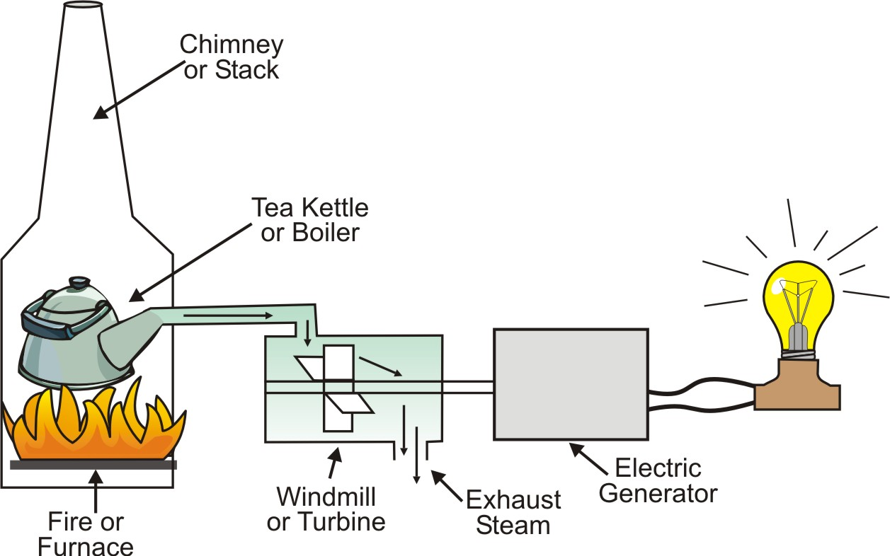
Enclosing the Components
Notes:
Discuss why enclosing the components would make a power plant more efficient. (i.e. reduces heat loss, better control of steam flow through the turbine, etc.)

Slide 6
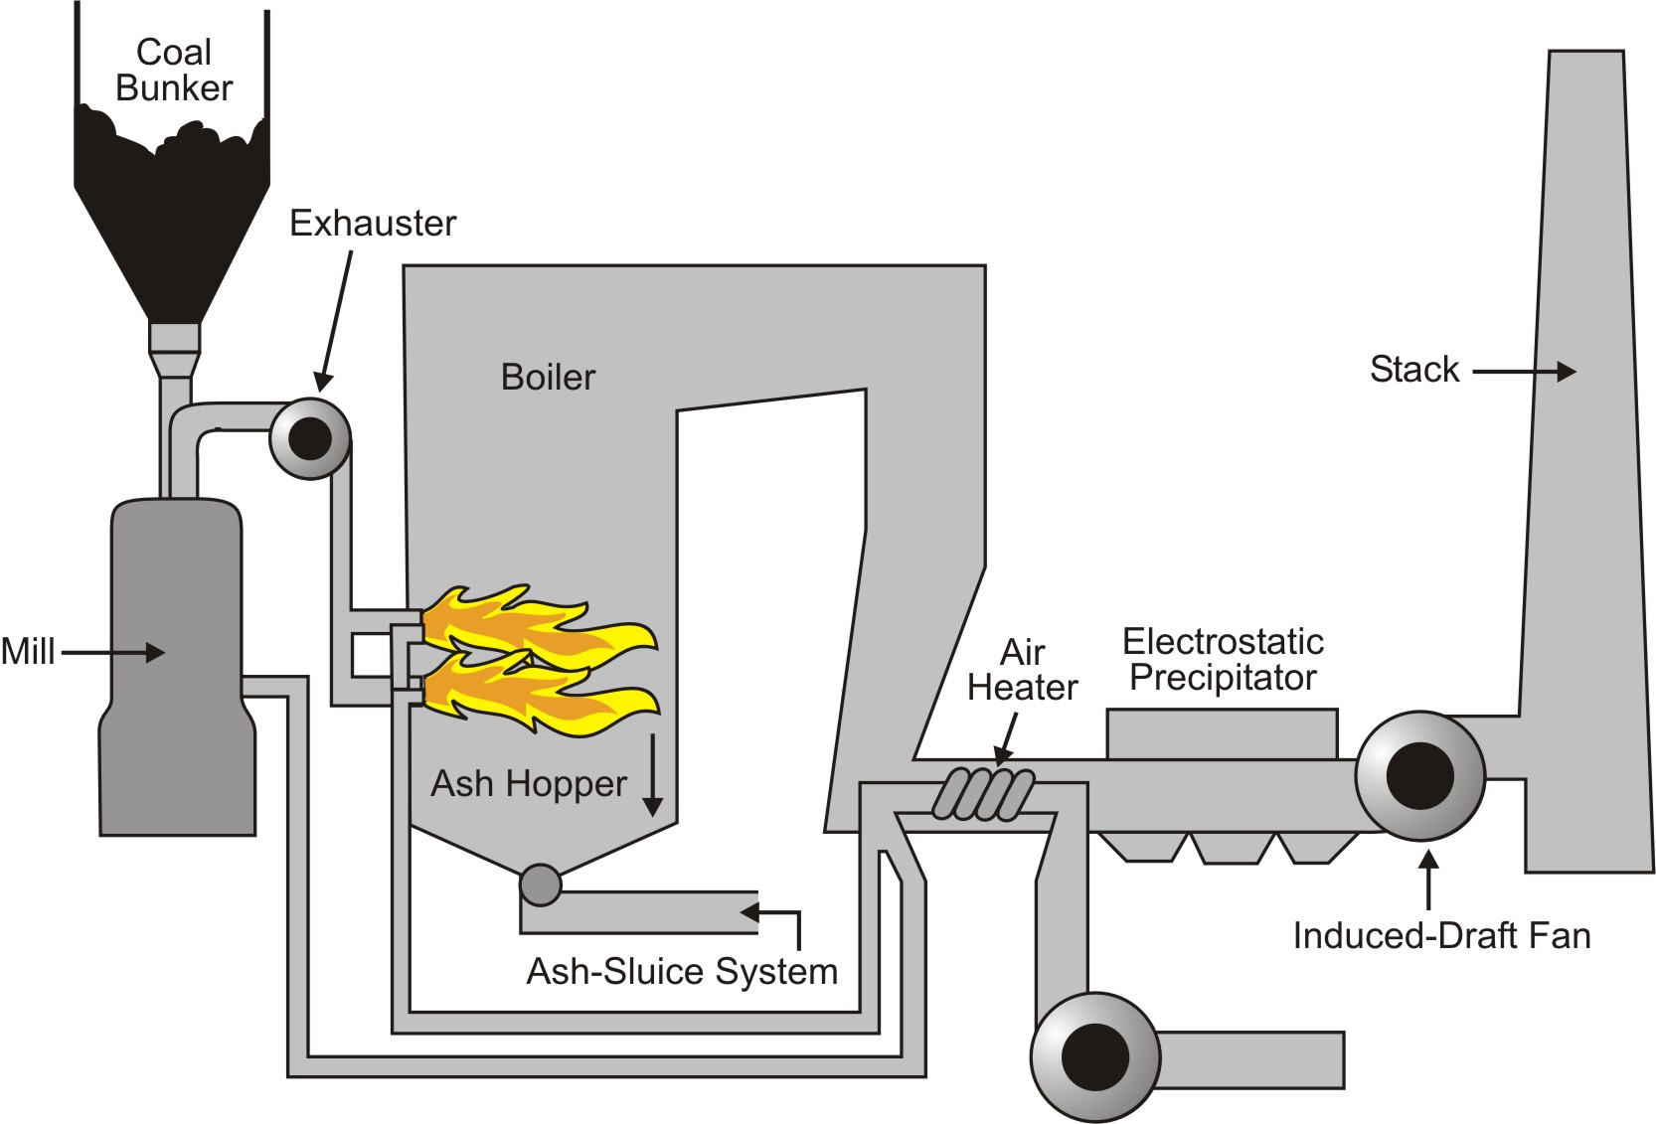
Furnace Improvements
Notes:
Furnace improvements are covered in the text section, How the Furnace Works.
There is a student worksheet on Furnace Theory also. You might want to let the students complete that worksheet as you discuss the improvements that are shown in this figure.

Slide 7
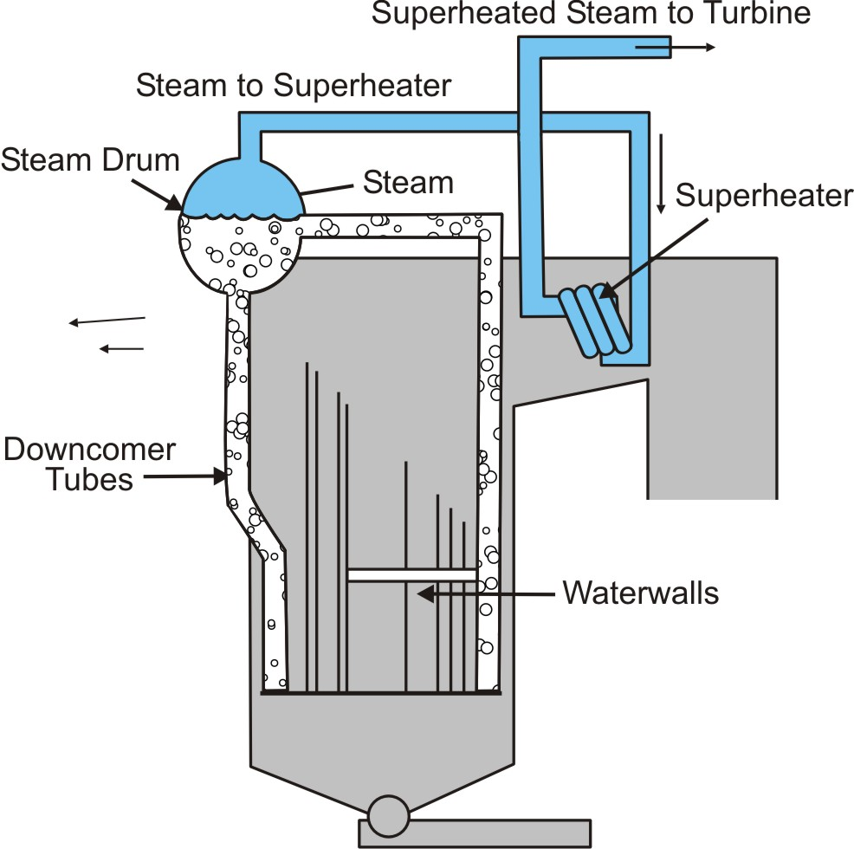
Boiler Improvements
Notes:
Boiler improvements are covered in the text section, How the Boiler Works. There is a student worksheet on Boiler Theory also. You might want to let the students complete that worksheet as you discuss the improvements that are shown in this figure.

Slide 8
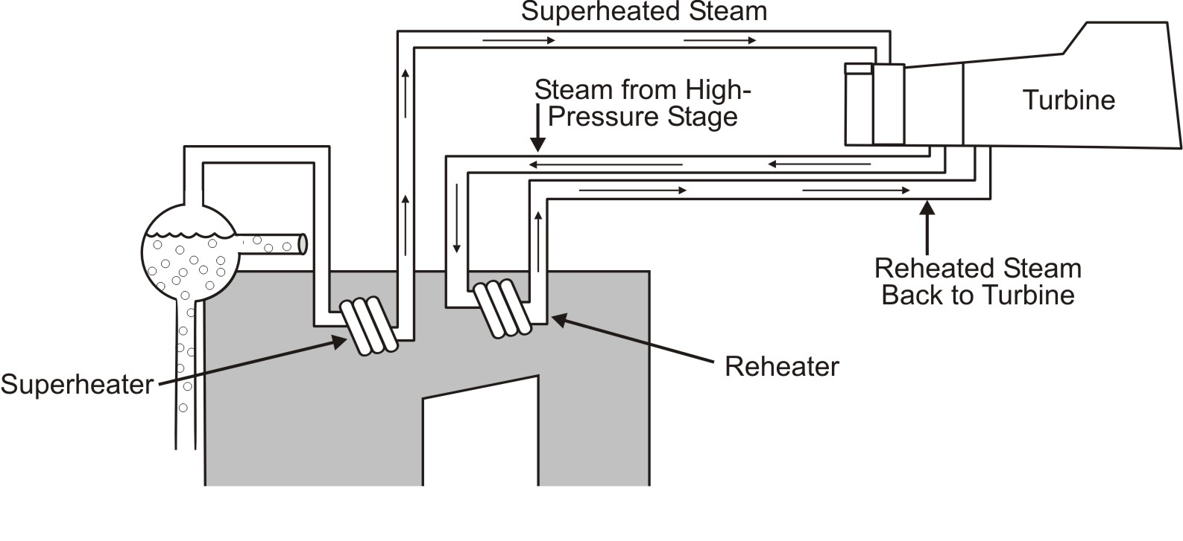
Turbine Improvements
Notes:
See the text section How the Turbine Works for a discussion of the improvements. In this diagram the focus is on superheating steam from the boiler to the turbine and reheating the steam between the high pressure and intermediate pressure stages of the turbine. The student worksheet covers turbine improvements as well as the boiler feedwater cycle and equipment.

Slide 9
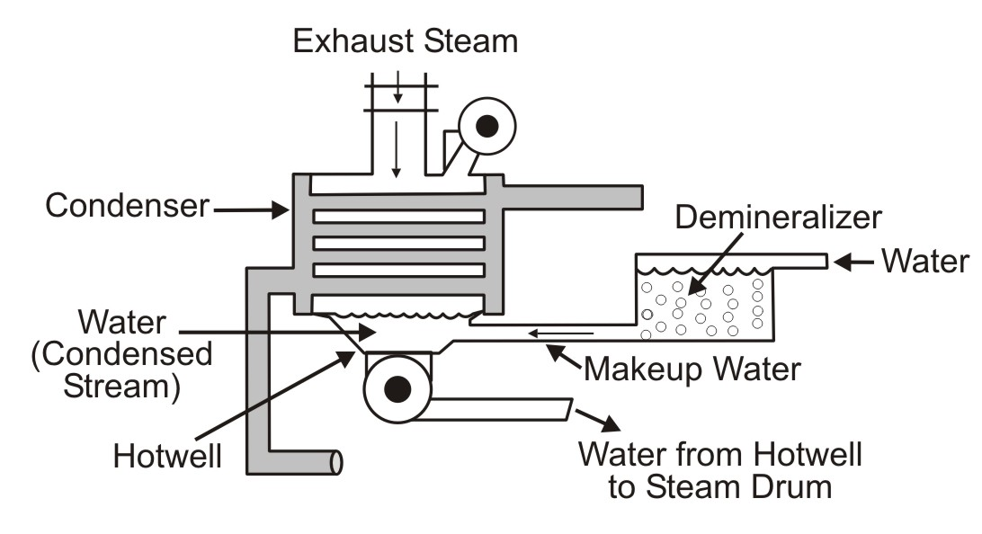
Condenser and Makeup Water
Notes:
Discuss how the condenser improves the efficiency of the turbine as well as recycles the treated water used in the boiler. Discuss the importance of using extremely pure water as makeup water to prevent scaling. If water were to contain naturally occurring minerals it would not take long for the water walls to become totally blocked from built up scale deposits.

Slide 10
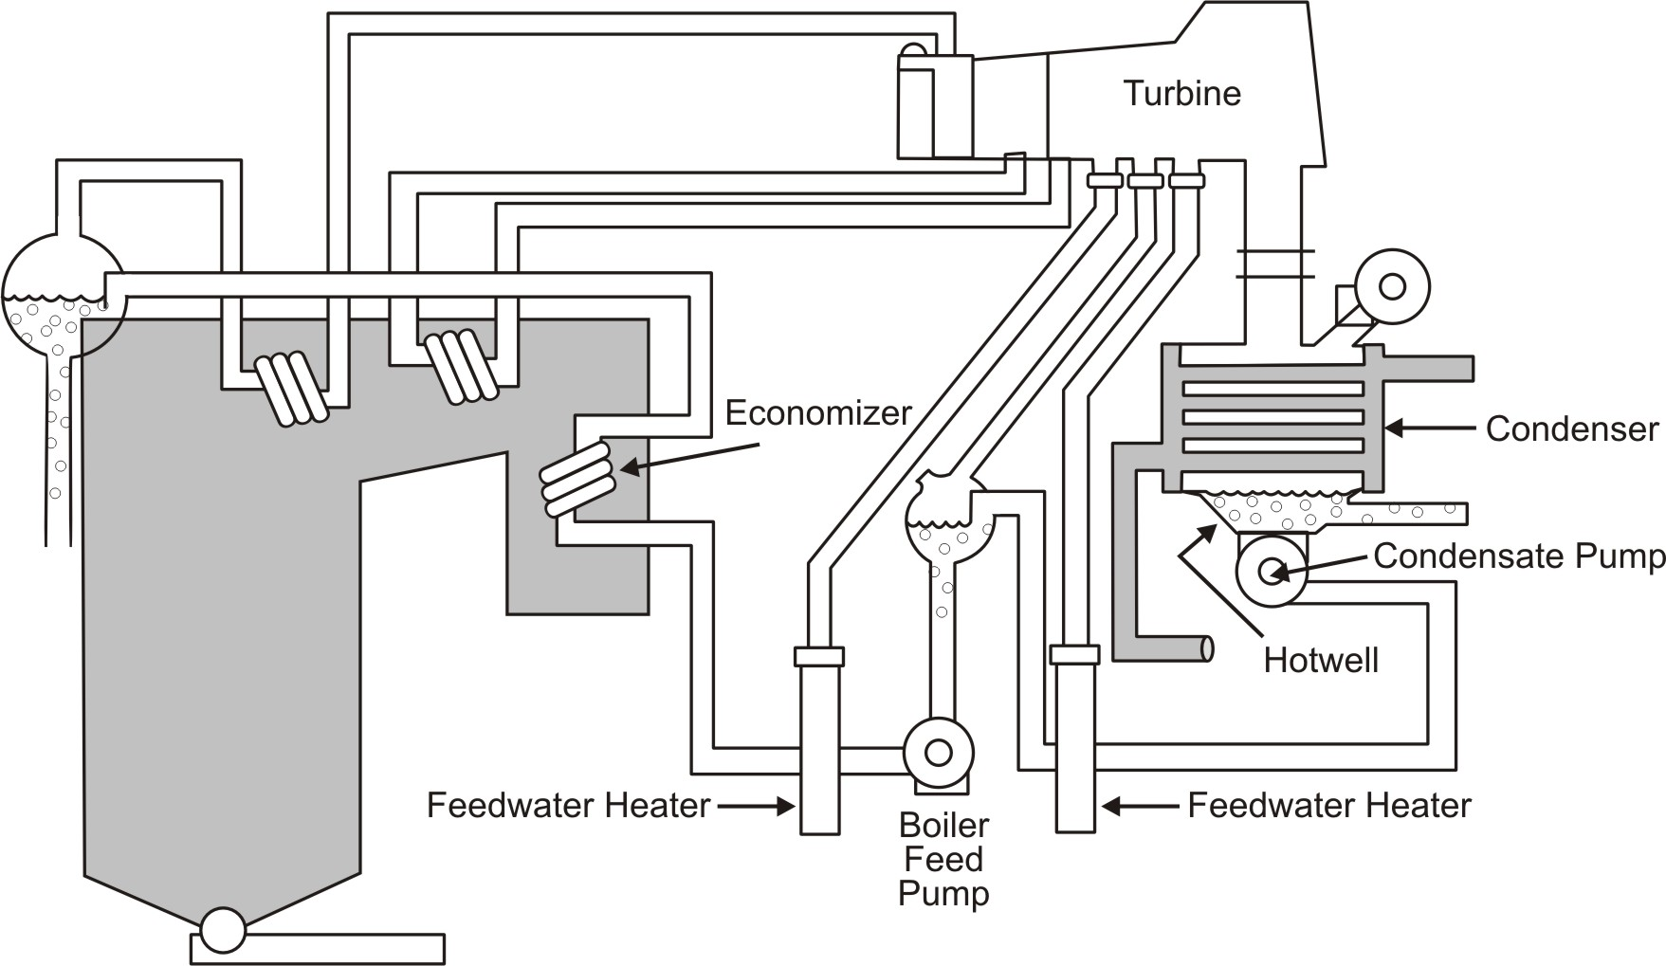
Feedwater System
Notes:
The improvements on this figure are discussed in the Boiler Feedwater Cycle section of the text. Ask students to identify unlabeled pars such as the evactor, the deaerating heater, path of the condenser cooling water, makeup water inlet and so forth.

