Slide 1

Hazard Communication ( HAZCOM) and the Globally Harmonized System of Classification and Labeling of Chemicals (GHS)

Slide 2
What is GHS?
  acronym for:
  Globally
  Harmonized
  System of Classification and Labeling of Chemicals
GHS

Slide 3
What is GHS?
  It is A SYSTEM. Elements of this system will be adopted by OSHA, to classify and communicate hazards of chemicals based on a common set of criteria
  GHS is a harmonized system for the classification and labeling of chemicals covering health, physical and environmental hazards.
  It provides a basis for the harmonization of regulations related to the handling of chemical materials at a global level.
Notes:
This system defines hazards, creates a classification process and communicates the information on labels and safety data sheets
Harmonization – implies the coordination, organization, management and synchronization of several elements. In this case of several criteria regarding handling of chemical materials.
A Harmonized System can be defined as the adjustment of differences and inconsistencies among different systems to make them uniform or mutually compatible. The GHS system is composed of several elements in such a way that the end result is an aligned system based on a common approach

Slide 4
What is GHS?
  GHS establishes
    Harmonized definitions of hazards
      Physical , health, environmental
    Specific criteria for labels
      Pictograms, signal words, hazard and precautionary statements
    Harmonized format for safety data sheets
      16 sections (ANSI format)
Notes:
4
The GHS covers physical, health, and environmental hazards. The work was divided in three parts:
Classification criteria for physical hazards – developed by United Nations Subcommittee/ International Labor Organization (ILO), based on the harmonized criteria for transport goods
Classification criteria for health and environmental hazards- developed under the Organization for Economic Cooperation
Hazard communication elements – developed by ILO

Slide 5
What is GHS?
Information should be presented in a
comprehensive manner to all audiences
Regarding chemicals:
  Confidential Business Information (CBI) should be protected without compromising worker safety

Slide 6
Hazard Communication (HCS) & GHS

Slide 7
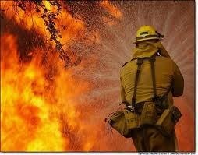



Target Sectors
GHS targets these sectors :
    Workplace
    Consumers
    Transport
    Emergency Responders
Notes:
Workplace – GHS will impact the physical and health hazard criteria, the label and safety data sheet elements and format and the employee training requirements. The environmental hazards may not be covered by all workplace systems
Consumers – GHS will impact mainly the labels of products with the adoption of the GHS hazard criteria
Transport - US Department of Transportation (DOT) has adopted GHS in the labels of dangerous goods
Emergency responders - the adoption of GHS hazard criteria should improve worker safety and safety practices when handling chemical substances

Slide 8
HCS Framework
Purpose - to ensure that the hazards of all chemicals produced or imported are evaluated, and that information concerning their hazards is transmitted to employers and employees.
Scope – worksites where employees could be exposed to hazardous chemicals
Notes:
Chemicals are used in every type of worksite at different levels. The amount of workers potentially exposed covers millions around the world.

Slide 9
Responsibilities under HCS
OSHA requires manufacturers and importers to evaluate the hazards related to chemicals they produce or import.
Employers are required to inform their employees about the hazards related to chemicals they might be exposed to and corresponding protective measures.

Slide 10
GHS – Hazard Classification
Health, Physical, Environmental

Slide 11

GHS: Environmental Hazards
Hazardous to the Aquatic Environment
  Acute – injury after short term exposure.
  Chronic – injury during the organism life cycle
  Includes fish, crustaceans, and algae or other aquatic plants.

Slide 12


GHS – Health Hazards

Slide 13
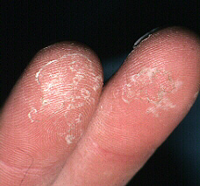
GHS Health Hazards
Acute Toxicity
Skin corrosion/Irritation
Serious eye damage/eye irritation
Respiratory or skin sensitization
Germ cell mutagenicity
Carcinogenicity
Reproductive toxicity
Target organ system toxicity – Single exposure
Target organ system toxicity – repeated exposure
Aspiration hazard
Notes:
Each of these hazard classes is divided into hazard categories.

Slide 14
Definitions: Health Hazards
Acute toxicity “refers to those adverse
effects occurring following oral or dermal
administration of a single dose of a substance,
or multiple doses given within 24 hours, or an
inhalation exposure of 4 hours”.

Slide 15

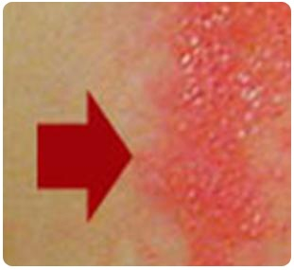
Definitions: Health Hazards
2. Skin corrosion is defined as “the
production of irreversible damage
to the skin; namely, visible necrosis
through the epidermis and into the
dermis, which was followed by the
application of a test substance for
up to 4 hours”.
Corrosive reactions are typified by ulcers, bleeding, bloody scabs.
Visible damage to skin after contact with substance
Notes:
15
Basically, contact with skin for up to four hours produces irreversible damage.

Slide 16

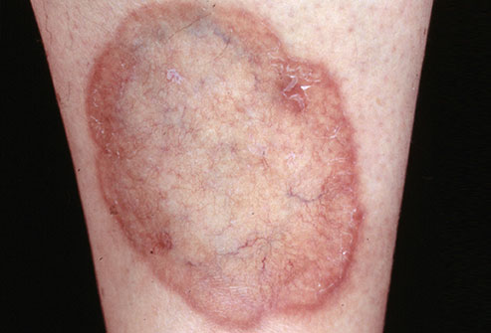
Definitions: Health Hazards
2.a. Skin irritation is defined as
“the production of reversible
damage to the skin following
the application of a test
substance for up to 4 hours”.
Before contact
After contact
Notes:
16
Basically, contact with skin for up to four hours produces reversible damage.

Slide 17

Definitions: Health Hazards
3. Serious eye damage is defined as the
production of tissue damage in the eye, or
serious physical decay of vision, following
application of a test substance to the
anterior surface of the eye, which is not
fully reversible within 21 days of application”.

Slide 18
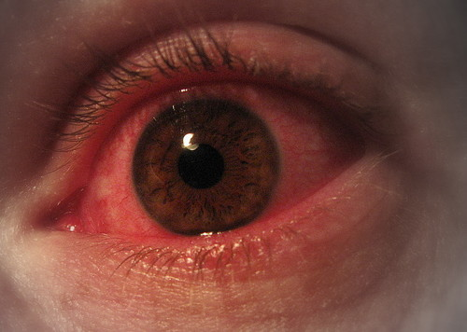
Definitions: Health Hazards
3.a. Eye irritation is defined as “the production of
changes in the eye following the application of
test substance to the anterior surface of the eye,
which are full reversible within 21 days of
application”.

Slide 19
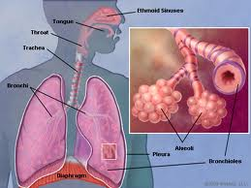
Definitions: Health Hazards
4. Skin sensitizer “means a chemical that induces
an allergic response following skin contact”.
4.a. Respiratory sensitizer “means a chemical that
will lead to hypersensitivity of the airways
following inhalation of the chemical”.
Notes:
19

Slide 20


Definitions: Health Hazards
5. Germ Cell Mutagenicity
A mutation “is defined as a permanent change in the amount or structure of the genetic material in a cell”.
The term mutagenic and mutagen “will be used for agents giving rise to an increased occurrence of mutations in populations of cells and/or organisms”.

Slide 21
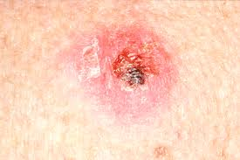
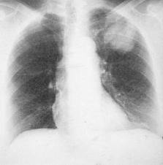
Definitions: Health Hazards
6. Carcinogen “means a substance
or a mixture of substances which
induce cancer or increase its
incidence.”
  Substances and mixtures which have induced benign and malignant tumors in well-performed experimental studies on animals are considered also to be presumed or suspected human carcinogens.
Skin cancer
Lung cancer
Notes:
Substances that have induced tumors of any kind will be considered carcinogens, unless there is strong evidence that the mechanism of tumor formation is not relevant for humans.

Slide 22


Definitions: Health Hazards
7. Reproductive toxicity “includes
adverse effects on sexual function
and fertility in adult males and
females, as well as adverse effects
on development of the offspring”.
  Adverse effects on development of the offspring means “any effect of chemicals which interferes with normal development of the conceptus either before or after birth”.

Slide 23

Definitions: Health Hazards
8. Specific Target Organ Toxicity (STOT)
STOT is caused by chemicals that are specific
target organ toxicants and, as such, present a
potential for adverse health effects in people who
are exposed to it.

Slide 24

Definitions: Health Hazards
9. Specific Target Organ Toxicity (STOT)
  Single exposure means
  “specific, non-lethal target
  organ toxicity arising from
  a single exposure to a
  chemical”.
  Repeated exposure requires
  more than one instance of exposure.

Slide 25

Definitions: Health Hazards
10. Aspiration means “the entry of a liquid or solid
chemical directly through the oral or nasal
cavity, or indirectly from vomiting, into the
trachea and lower respiratory system”.
  Includes severe acute effects such as chemical
  pneumonia, varying degrees of pulmonary injury or
  death following aspiration.
Notes:
Category 2 of Aspiration Hazard was not adopted by OSHA.

Slide 26





GHS – Physical Hazards

Slide 27
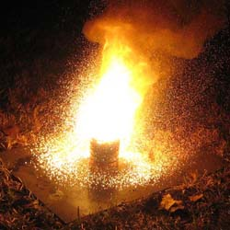
GHS - Physical Hazards
Explosives
Flammable gases
Flammable aerosols
Oxidizing gases
Gases under pressure
Flammable liquids
Flammable solids
Self-reactive substances and mixtures
Pyrophoric liquids
Pyrophoric solids
Self-heating substances and mixtures
Substances and mixtures which, in contact with water, emit flammable gases
Oxidizing liquids
Oxidizing solids
Organic peroxides
Corrosive to metals
Notes:
OSHA has the adopted GHS criteria for all physical hazards. The physical hazards criteria in Appendix B are based on the UN Recommendations for the Transport of Dangerous Goods (RTDG) already used by US DOT in the hazards material regulations . Therefore the transport labels remains the same.

Slide 28

Physical Hazards…
1. Explosive Substances and Mixtures
    Solid or liquid substances capable of producing gas at such a high temperature and pressure that it can cause damage to surroundings.
Notes:
These are similar to the subcategories for the transport sector.
Pyrotechnic chemicals are included even when they do not evolve gases.
A pyrotechnic chemical is a chemical designed to produce an effect by heat, light, sound, gas or smoke or a combination of these as the result of non-detonative self sustaining exothermic chemical reactions.
An explosive item is an item containing one or more explosive chemicals.
A pyrotechnic item is an item containing one or more pyrotechnic chemicals.
An unstable explosive is an explosive which is thermally unstable and/or too sensitive for normal handling, transport, or use.
An intentional explosive is a chemical or item which is manufactured with a view to produce a practical explosive or pyrotechnic effect.

Slide 29

Physical Hazards...
Flammables, include
  Flammable Gases
  Flammable Aerosols
  Flammable Liquids
  Flammable Solids
Notes:
Flammables
Flammable Gases
Have a flammable range in air at 20 degrees C (68 F) and a pressure of 101.3 kilopascals (14.7 psi).
Flammable Aerosols
They are compressed, liquefied or pressurized gas that eject from the container in a foam, powder or liquid state. Classification of aerosols will depend upon concentration of flammables and heat of combustion among other test s
Flammable Liquids
Any liquid with a flash point of 93 degrees C ( 199.4 F) or less. Divided in 4 categories based on flash point and boiling point temperature
Flammable Solids
A solid, usually in a powder or granular form, that is easily combustible through friction like some metal powders. Divided in 2 categories based on burning time, burning rate and behavior when wet.

Slide 30

Physical Hazards...
2. Flammable gas means a gas having a flammable
range with air at 20°C (68 F) and a standard
pressure of 101.3 kPa (14.7 psi).
Notes:
.

Slide 31
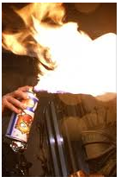
Physical Hazards...
3. Aerosol means “any non-refillable receptacle
containing a gas compressed, liquefied or
dissolved under pressure, and fitted with a
release device allowing the contents to be
ejected as particles in suspension in a gas,
or as a foam, paste, powder, liquid or gas.”

Slide 32
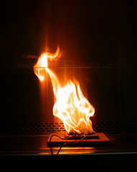
Physical Hazards …
4. Oxidizing gas “means any gas
which may, generally by providing
oxygen, cause or contribute to the
combustion of other material more
than air does”.
13-14. Oxidizing Liquids and Solids
  Though not necessarily combustible on their own, generally by yielding oxygen cause or contribute combustion of other material.
Notes:
Oxidizers provide oxygen thus enhancing flammabililty

Slide 33

Physical Hazards ...
5. Gases Under Pressure
  Gases contained in a receptacle at a pressure of 200 kPa (29 psi) or more, which are liquefied or liquefied and refrigerated
  Includes 4 groups: compressed gases, liquefied gases, dissolved gases and refrigerated liquefied gases
Notes:
Contained in a receptacle at not less 200 kPa (29 psi) @ 20 ºC (68 F). May explode from container if heated
Compressed gas is entirely gaseous at -50ºC (-58 F)
Liquefied gas is partially liquid at temperatures over 50ºC (122 F)
Refrigerated liquefied gas is partially liquid because of its low temperature
Dissolved gas is a gas dissolved in a liquid phase solvent

Slide 34
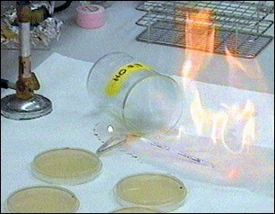

Physical Hazards...
6. Flammable Liquids
  Any liquid with a flash point of 93 degrees C (199.4 F) or less.
7. Flammable Solids means a
solid, usually in a powder
or granular form, that is
easily combustible through
friction.
Notes:
Flammable Solids
A solid, usually in a powder or granular form, that is easily combustible through friction like some metal powders. Divided in 2 categories based on burning time, burning rate and behavior when wet.

Slide 35
Physical Hazards …
8. Self-reactive chemicals are thermally
unstable liquid or solid chemicals liable to
undergo a strongly exothermic
decomposition even without participation of
oxygen (air).
Notes:
A self-reactive chemical is regarded as possessing explosive properties when in laboratory testing the formulation is liable to detonate, to deflagrate rapidly or to show a violent effect when heated under confinement.

Slide 36
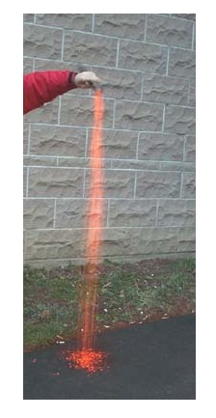
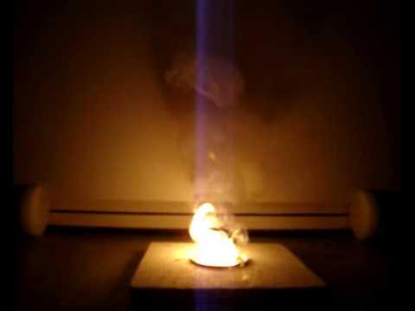
Physical Hazards …
9-10. Pyrophoric Solids & Liquids means a solid
liquid “which, even in small quantities, is
liable to ignite within five minutes after
coming into contact with air”.
Notes:
The minimum temperature at which these liquids can ignite is below room temperature.

Slide 37
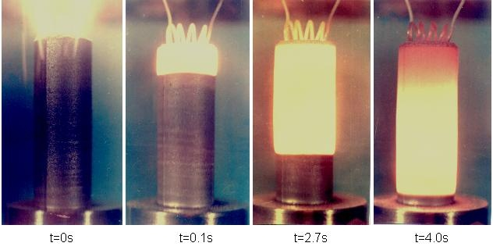

Physical Hazards …
11. Self-Heating Chemicals
  Solids or liquids, other than pyrophoric, which by reaction with air and without energy supply is liable to self heat.
  They require large amounts of material and long periods of time to ignite.
Notes:
37
These are not pyrophorics

Slide 38
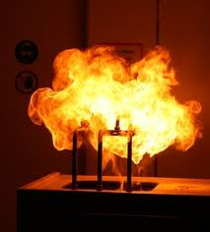
Physical Hazards …
12. Chemicals which in contact with water, Emit Flammable Gas are solid or liquid chemicals which, by interaction with water, are liable to become spontaneously flammable or to give off flammable gases in dangerous quantities.

Slide 39
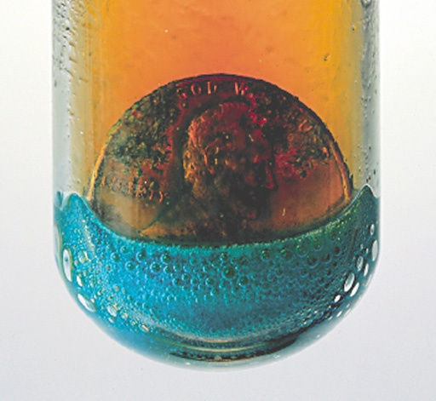

Physical Hazards …
15. Organic Peroxides means
organic liquids or solids that
can decompose explosively,
burn rapidly, be sensitive to
friction and react dangerously
with other chemicals.
16. Corrosive to Metals “means a
chemical which by chemical
action will materially damage,
or even destroy, metals”
Notes:
The categories are divided based upon material explosive properties. Peroxides can decompose in an explosive manner, burn rapidly, be sensitive to friction and react dangerously with other chemicals

Slide 40
Pause
Notes:
Take a moment to answer any questions of material discussed up to here. Make quick review on board

Slide 41
GHS – Hazard Communication Tools
Labels

Slide 42
Label Components
    Product identifier
    Supplier identifier
    Chemical identity
    Hazard pictograms*
    Signal words*
    Hazard statements*
    Precautionary information - mandatory
  *Standardized Based on Appendixes

Slide 43

Product Identifier
States the identity of the chemical, including all the ingredients that contribute to the hazard of the mixture.
Unique means by which the chemical can be identified within the particular use setting.
Notes:
Name or number used for a hazardous product on a label and on the SDS.
UN proper shipping name should also be used on the package when the chemical (substance or mixture) is covered by the UN RTDG.

Slide 44
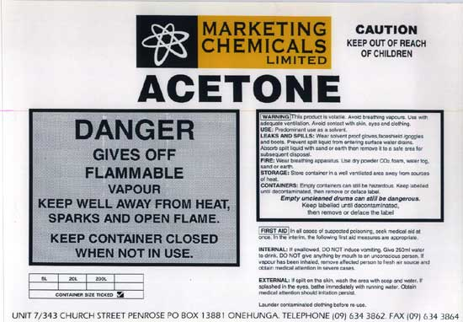
Supplier Information
Supplier Identification
Name, address and telephone number of the manufacturer or supplier of the hazardous chemical.
Notes:
44

Slide 45
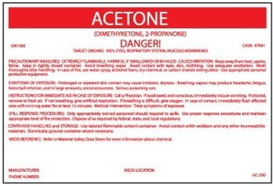
Chemical identity
A name that will uniquely identify a chemical.
For Substances
  Name as determined by IUPAC or CAS,
  or technical name as determined by ISO.
Notes:
IUPAC – International Union of Pure and Applied Chemistry
CAS – Chemical Abstract Service
ISO – International Organization for Standardization

Slide 46
Chemical identity
For Mixtures
  Identities of all ingredients contributing to health hazards, OR
  All ingredients that contribute to the hazard of the mixture.
Notes:
46
Identities of all ingredients contributing to
acute toxicity,
skin or eye corrosion,
germ cell mutagenicity,
carcinogenicity,
reproductive toxicity,
skin or respiratory sensitisation,

Slide 47
GHS - Pictograms

Slide 48
Pictograms
Display health, physical and
environmental hazard information

Slide 49
Pictograms
Pictograms feature a white background with a red border instead of a solid orange background.
Harmful chemicals are marked with an exclamation mark.
Notes:
49

Slide 50





GHS Pictograms
Exploding bomb Explosives; Self Reactive; Organic Peroxides | Skull and Crossbones Acute toxicity (severe) | Flame Flammables; Pyrophorics; Self-Heating; Emits Flammable Gas; Self Reactive; • Organic Peroxides
Gas Cylinder Gases under pressure | Health Hazard Carcinogen; Mutagenicity; Reproductive Toxicity; Respiratory Sensitizer; Target Organ Toxicity; Aspiration Toxicity | Flame over circle Oxidizers
Corrosion Corrosives | Exclamation mark Irritant; Skin Sensitizer; Acute Toxicity (harmful); Narcotic effects; Respiratory Tract Irritant; Hazardous to Ozone Layer | Environmental Aquatic Toxicity (OSHA did not propose this pictogram)

Slide 51
Pictogram Shape & Colour
For transport, pictograms will not change
For other sectors, pictograms will have a black symbol on a white background with a red diamond frame.
For the same hazard, where a transport pictogram appears, the GHS pictogram should not appear.
Notes:
For transport, pictograms will have the background and symbol colors currently used.
For other sectors, pictograms will have a black symbol on a white background with a red diamond frame. A black frame may be used for shipments within one country. OSHA will maintain the red border.
The transport pictogram has precedence over the GHS pictogram if the same hazard is present

Slide 52

Signal Words
These words are used to alert the reader of health, physical, and environmental hazards, and the hazard’s level of severity
“Danger” and “Warning” are the only two signal words used.
Notes:
52
Words shown here are those used by the ANSI Z129.1 standard, American National Standard for hazardous Industrial Chemicals – Precautionary Labeling.
Danger – most harmful to person, because of toxicity or exposure, more severe or persistent effects
Warning - less harmful to person, lower levels of exposure or toxicity or temporary harmful effects
Lower levels of danger or exposure typically used “Caution” or “Notice” as the warning word
Studies showed people identify these words with different levels of risks or hazards, but saw little differences between the words Caution and Warning

Slide 53

GHS – Hazard Communication Tools: Safety Data Sheets
From MSDS to SDS

Slide 54
Role of the SDS in the GHS
Primary Use of SDS: The Workplace
Employers and workers use them as an information source about hazards of a chemical substance or mixture and to obtain advice on safety precautions.
SDS information can be used by those involved in the transport of dangerous goods and emergency responders.
Notes:
It’s information enables the employer to develop an active program of worker protection measures, including training specific to the workplace.

Slide 55
When is an SDS required?
An SDS should be produced for all chemicals (substances and mixtures) which meet the harmonized criteria for physical, health or environmental hazards under the GHS and …
For all mixtures which contain substances that meet the criteria for:
  Carcinogens,
  Toxic to reproduction or
  TOST in concentrations exceeding the cut-off limits specified by the criteria for mixtures.

Slide 56
Safety Data Sheet - Content
1. Identification
2. Hazard (s) identification
3. Composition/ information on ingredients
4. First-aid measures
5. Fire-fighting measures
6. Accidental release measures
7. Handling and storage
8. Exposure control/ personal protection
9. Physical and chemical properties
10. Stability and reactivity
11. Toxicological information
12. Ecological information
13. Disposal considerations
14. Transport information
15. Regulatory information
16. Other information
OSHA proposes sections 1-11 and 16 be mandatory
Not under OSHA jurisdiction

Slide 57


Safety Data Sheet - Content
Safety Data Sheets: Will now have a specified 16-section format. Revisions every 3-5 years
Information and training: The proposed standard will require that workers are trained within two years of the publication of the final rule to facilitate recognition and understanding of the new labels and safety data sheets.
Notes:
OSHA is proposing to adopt the SDS format (ANSI model) where sections 1 -11 and section 16 be mandatory and sections 12 -15 would be non-mandatory
MSDS revisions every 3-5 years
Appendix D, Safety Data Sheets, provides the details of what is to be included in each section
Required information:
Chemicals recommended use & restrictions
GHS class and classifications of the substances & mixtures and any regional information
GHS labeling elements
CAS # of hazardous components and impurities
The criteria for MSDS component disclosure also differs between the two systems. The level of hazardous components can be given as ranges or concentrations under GHS, whereas the HCS specifies percentages.

Slide 58

Additional Information
OSHA’s website on GHS
  http://www.osha.gov/dsg/hazcom/global.html

Slide 59

HAZCOM - GHS
?

